Slide 1
Slide 1
Year in Review
Association of Charter School Education Services
Notes:
These can be changed to reflect your school’s specific rules.

Slide 2
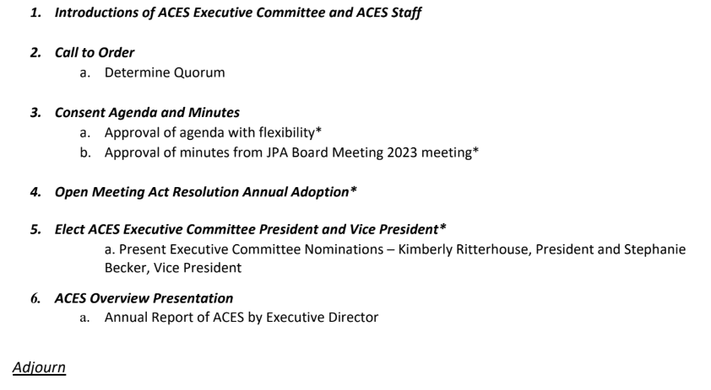
agenda
Annual JPA Membership Board Meeting

Slide 3
Slide 3

Slide 4
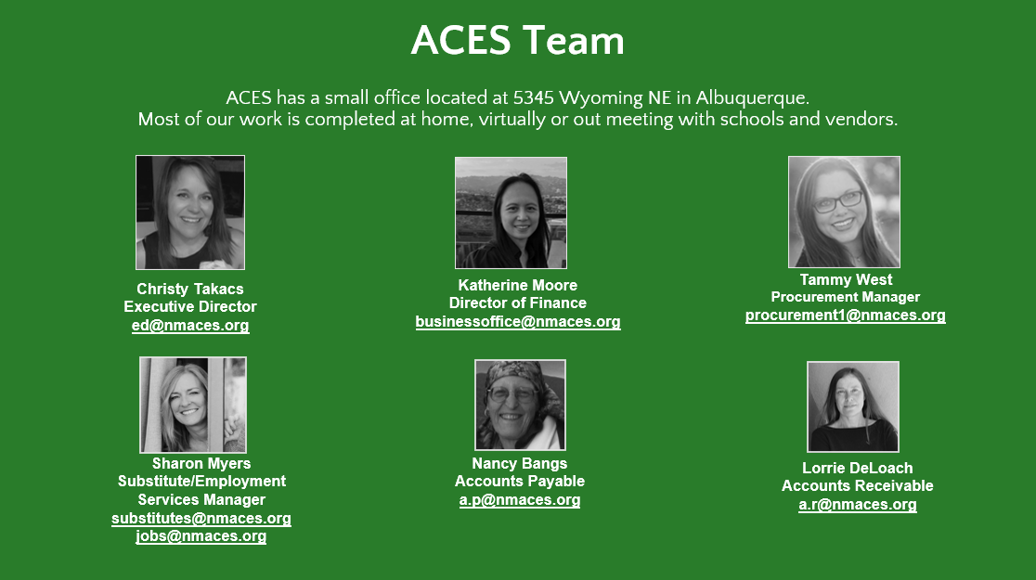
Slide 4

Slide 5
agenda
Annual JPA Membership Board Meeting

Slide 6
Slide 5
ACES MEMBERSHIP
100 Charter School Members
New America Albuquerque
Sun Mountain Community School
Sacramento School of Engineering and Science
21 School Districts or other Government Agencies
Bernalillo Public Schools
Laguna Department of Education
Chama Valley Independent Schools
Espanola Public Schools
Mesa Vista Consolidated Schools
Socorro Consolidated Schools
Notes:
*Change this verbiage to the language your school uses.

Slide 7
Slide 6
YEAR IN REVIEW
2024 Contract Awards
2024 Changes
Fencing Materials and Related Services – 2 awards
Educational Technology – 4 awards
Handyman Services – 2 awards
Unarmed Security Personnel – 1 award
Temporary Staffing – 1 award
Elimination of 3 Party Agreement – Streamline the process by issuing a PO
Updated logo and website to include access to vendor contracts
Looking Forward
Add procurement personnel
Continue to grow membership by adding districts and governmental agencies
Continuous solicitation schedule based on school needs

Slide 8
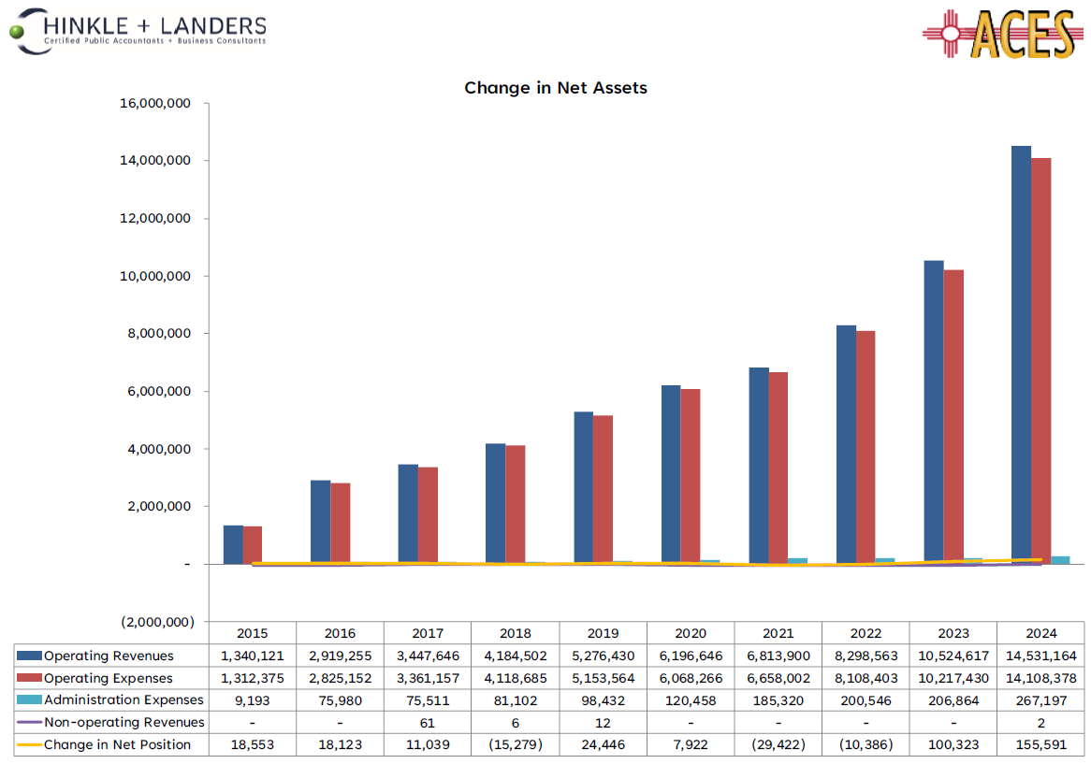
Slide 7
AUDIT HIGHLIGHTS
Significant increase in revenue
Clean audit – no findings
Access audit and approved budget on our website
Closely monitor our budget/programs; continuous solicitations; multiple awards; focus on marketing ACES; always looking for ways to grow

Slide 9
Check out our new website
https://nmaces.org/

Slide 10
Slide 1
THANK YOU FOR YOUR SUPPORT
Notes:
These can be changed to reflect your school’s specific rules.

Slide 11
agenda
Annual JPA Membership Board Meeting

